Slide 1
E-invoicing Training conference
Towards electronic invoicing in 2020:
a short introduction
Nicosia - October 30, 2017
Andrea Caccia, CEN/TC 434 chair
This presentation expresses the position of the above mentioned presenter. Not of CEN.

Slide 2
eInvoicing in EU: some background
EC Communication COM(2010) 712 final - 2010.12.02: “Reaping the benefits of electronic invoicing for Europe”
EUR 240 billions savings in 6 years
e-invoicing predominant method by 2020 in EU
The European Parliament called for making e-invoicing compulsory in public procurement by 2016 in a resolution adopted in April 2012

Slide 3
Some background information
The European Multi-Stakeholder Forum on electronic Invoicing (EMSFEI) unanimously adopted on Oct 2013 a
"Recommendation on the use of a Semantic Data Model to support Interoperability for Electronic Invoicing"
Adoption of Directive 2014/55/EU on electronic invoicing in public procurement
Sector Section
Common Section
Core Invoice
Legal Section
Country Specific Section

Slide 4
Goals of Directive 2014/55/EU
Reducing complexity, legal uncertainty and additional operating costs for economic operators when using e-invoices across Member States
Promoting the uptake of e-invoicing in public procurement and in the private sector in order to generate significant benefits for Member States and economic operators
Complementing the efforts for the uptake of e-procurement as reflected in Directives 2014/24/EU and 2014/25/EU

Slide 5
Why this European Standard?
Directive 2014/55/EU (Art. 3) requires the Commission to ask the relevant European standardization Organization:
to draft a European standard (EN) for the semantic data model of the core elements of an electronic invoice;
to provide a list with a limited number of syntaxes complying with the European Standard, the appropriate syntax bindings and guidelines on transmission interoperability.
Requires also that the standard shall be tested as for its practical application for an end user

Slide 6
CEN/TC 434 on Electronic Invoicing
The Directive imposed a short time frame: CEN/TC 434 was established already in September 2014 before the official request
The directive included requirements for the European standard:
Technologically neutral
Compatible with relevant international standards
Consistent with personal data protection requirements
Consistent with the VAT Directive (2006/112/EC)
Allowing practical, user-friendly, flexible, cost-efficient systems
Considering SMEs and sub-central contracting authorities/entities needs
Suitable for commercial transactions between enterprises
10/12/2014 – The Commission issued the official standardisation request with all the details to finalize the TC workplan

Slide 7
Deliverables from CEN/TC 434
All documents were unanimously approved and are published by CEN (i.e. available to the National Standardization Organizations)
Toolset for Directive 2014/55/EU implementation
Reference |  | Topic (not official title)
EN | 16931-1 | European Standard for the semantic data model of the core elements of an electronic invoice i.e. the content of the invoice valid in Europe
TS | 16931-2 | A Technical Specification giving a short list of internationally used syntaxes (UBL & CII) that comply with the EN and that public administrations shall support
TS | 16931-3-1 … 16931-3-4 | A set of 4 technical specifications for syntax binding methodology and 3 syntax bindings with the EN for UBL, CII and EDIFACT
TR | 16931-4 | Transmission guideline
TR | 16931-5 | EN extension methodology
TR | 16931-6 | Test results

Slide 8
Directive implementation requirements
EN and short list of syntaxes (parts 1 and 2)
Testing practical application for an end user (practicality, user-friendliness and possible implementation costs)
CEN/TR 16931-6 (TC 434)
Study on the practical application and implementation of the European e-Invoicing standard (PWC)
Report from the Commission to the European Parliament and the Council on the assessment of the EN (Oct 11, 2017)
Commission Implementing Decision (EU) 2017/1860 of 16 October 2017 (published in OJEU on Oct 17, 2017)

Slide 9
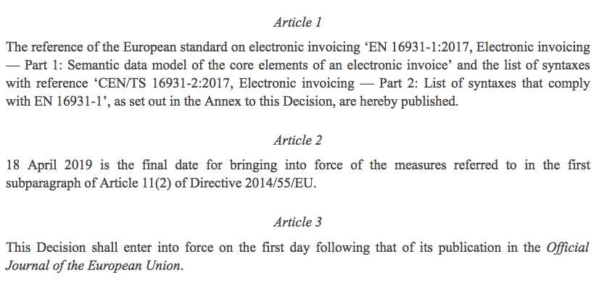
Decision 2017/1860

Slide 10
Questions?

