Slide 1
Support for syntaxes
(UBL and UN/CEFACT)
Nicosia
October 30, 2017
Andrea Caccia
This presentation expresses the position of the above mentioned presenter., not of CEN.

Slide 2
Setting up an e-invoicing system
Definition of electronic invoice from Directive 2014/55/EU:
an invoice that has been issued, transmitted and received in a structured electronic format which allows for its automatic and electronic processing
No ”image” or “simple PDF” invoice
Suppliers and buyers that use structured invoice data establish a direct two-way communication or use a service provider for e-invoice exchange
inbound and outbound e-invoicing can be practiced in a centralised manner increasing transparency and allowing straight trough processing and cash management

Slide 3
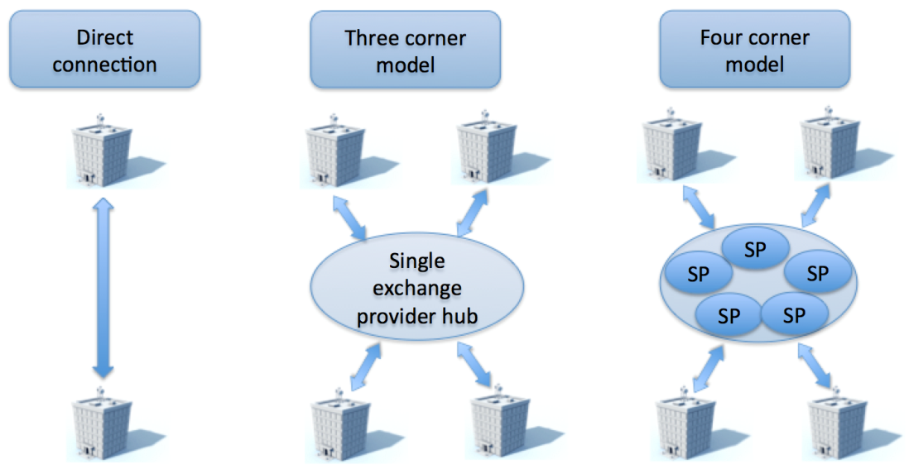
Common operating models
From TR 16931-4

Slide 4
Direct Connection model
In a bilateral scenario trading parties are responsible for agreeing at a commercial level the basis on which they will work together and are required to agree on all levels of interoperability, business, semantic and technical details
Where possible, one or other of the trading parties may work to ensure the maximum degree of standardization in their dealings with as many parties as possible
Bilateral exchanges vary enormously in scale and scope from tightly integrated supply chains employing EDI, ERP to ERP direct connections, and EIPP/EBPP (Electronic Invoice or Bill Presentment and Payment) web-portals.

Slide 5
Four-corner model
Service providers interoperate as required by their users through bilateral linkages between them or through the creation of multilateral network solutions
Trading parties are connected to their own service providers or access points, which interoperate with each other: avoid the need to create multiple differing connections with all their own trading parties
The PEPPOL (see http://www.peppol.eu ) e-Delivery Network in the e-Procurement domain is an implementation of the four-corner model with community based interoperability
Lifecycle management and legal governance utilizes CEF e-Delivery capabilities for message exchange, dynamic discovery and look-up, PKI based trust services

Slide 6
Support for syntax from CEN: syntax bindings
Reference |  | Topic (not official title)
EN | 16931-1 | European Standard for the semantic data model of the core elements of an electronic invoice i.e. the content of the invoice valid in Europe
TS | 16931-2 | A Technical Specification giving a short list of internationally used syntaxes (UBL & CII) that comply with the EN and that public administrations shall support
TS | 16931-3-1 … 16931-3-4 | A set of 4 technical specifications for syntax binding methodology and 3 syntax bindings with the EN for UBL, CII and EDIFACT
TR | 16931-4 | Transmission guideline
TR | 16931-5 | EN extension methodology
TR | 16931-6 | Test results

Slide 7
Syntax binding: methodology
Different invoice formats are supported with syntax bindings
TS 16931-3-1 specifies the methodology of the mapping between:
the semantic model of an electronic invoice, included in EN 16931-1 and
a syntax, i.e. an invoice syntax with its own model

Slide 8
Syntax binding: methodology
Specifies which element in the syntax is to be used for the information contained in each element in the semantic model, including
Any sub-elements
supplementary components such as Identification scheme identifiers
Any mismatches between semantics, format, cardinality or structure are indicated

Slide 9
Syntax bindings
Bindings to:
UBL 2.1 - ISO/IEC 19845 -> TS 16931-3-2
UN/CEFACT XML Core Invoice D16B -> TS 16931-3-3
EDIFACT INVOIC D16B -> TS 16931-3-4 (not mandatory for public authorities)
Two tables per binding :
Core elements to syntax (normative)
Syntax to core elements (reference information for implementers)
Indication of mismatches
Validation artefacts

Slide 10
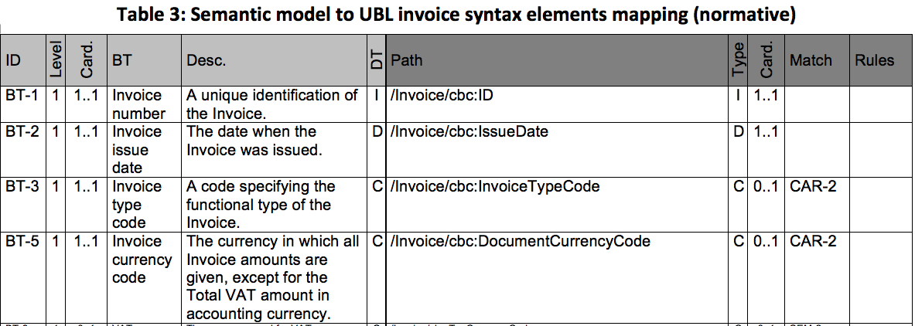
Syntax bindings example: UBL
Clause 4.3: Mapping the Invoice model

Slide 11
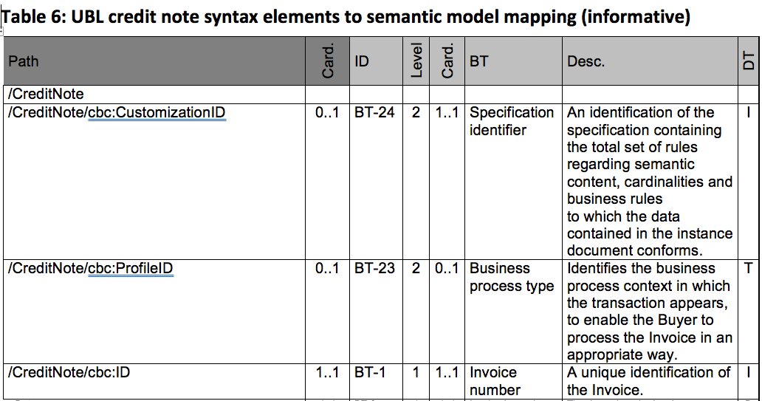
Syntax bindingsexample: UBL
Clause 4.3: Mapping the Invoice model

Slide 12
How to support implementation?
Identification and implementation of guidance and user support for agreed requirements
Identification of requirements for the development of ‘Common’ Extensions to meet European-level and ‘multi-sectoral’ needs for such Extensions
Requirements, governance of registry services to users of the EN in relation to a set of defined items where registration is agreed to be required (e.g. extensions, Core Invoice Usage Specifications, code lists, …)

Slide 13
How to support implementation?
The public sector is the biggest buyer but B2B counts for 85%: private sector requirements support is key
Open source, APIs, Business use cases, ... The new CEN Digital Transformation Strategy can give answers
A “phase 2” for CEN/TC 434 was agreed at the last plenary in Milan, Oct 12-13 2017

Slide 14
Questions?

