Slide 1


Implementation of
ISO 37001 Anti-Bribery Management System Standard
at Bank of Cyprus
Kalia Larkou – Manager
Regulatory & Ethics Compliance Department
14 September 2017

Slide 2

Culture

Slide 3

Culture…
Culture is nothing more than a set of impressions in our mind.
Our mind- set,
professional behaviour,
our values.
BoC Management, employees and other stakeholders think and behave towards Bribery hazards and anti-corruption measures?

Slide 4

How do we cultivate the Anti-corruption Culture?

Slide 5

How do we measure Anti-corruption Culture?

Slide 6
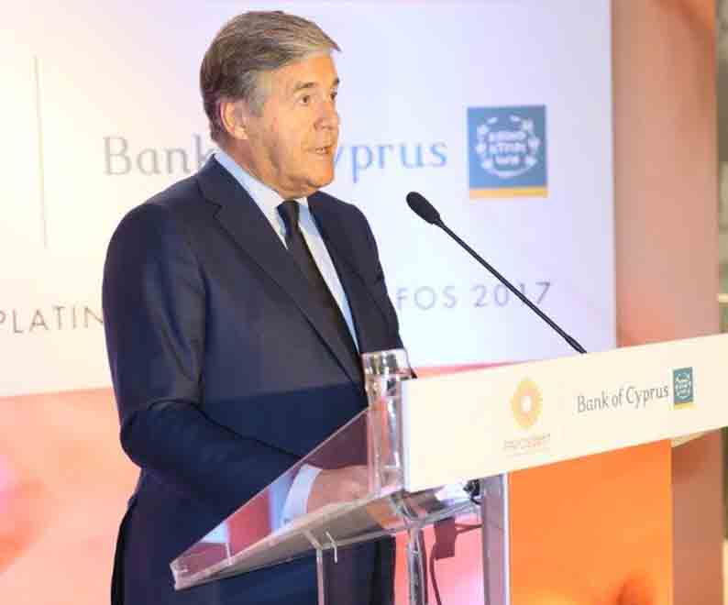
The Board of Directors applies a "zero tolerance" approach to acts of bribery and corruption by any of our employees or any business partners.

Slide 7
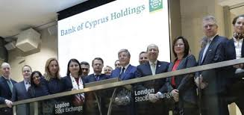

Recognition of BOC New Culture
London Listing
2017 Best Corporate Governance Award – Cyprus by World Finance Magazine
  Positive benchmarking by Spencer Stuart as to our Corporate Governance Model compared to other European Financial Institutions (independent external consultants assessing the new corporate governance framework of our Bank in 2015).
  2016 Award for Best Practices, Initiatives/Actions to Reduce Corruption and/or Strengthen Transparency in Cyprus, by Transparency International (Cyprus).

Slide 8
Key Pillars of BOC Anti-Bribery
Framework Vs ISO 37001
Anti-Bribery Policy and management systems
Leadership and commitment
Performance evaluation
Support
Operation and due diligence
Understanding the Bank operations
Risk assessment

Slide 9
Pillar 1: Understanding the Bank’s operations
Regulators
Society
Board of Directors
Employees
Customers
Shareholders
Business associates
Consultants
Activities and Operations
Media
Vendors
Public officials

Slide 10
Pillar 2: Anti-Bribery Management System
Integrated Anti-Bribery Management System
Core Principles

Slide 11
Group Anti-Bribery Policy
The policy begins with a clear and unambiguous statement that bribery of any kind will not be tolerated.
The Board of Directors applies a "zero tolerance" approach to acts of bribery and corruption by any of our employees or any business partners.
Any breach of the Anti-Bribery policy will be regarded as a serious offence by the Group and it will result in disciplinary action.
The Group encourages all employees to report any suspicious activity that may violate this policy.
A confidential and discrete way to report any violations or suspicious activity is in place.
All responsibilities are clearly assigned, explained and monitored through the Anti-Bribery and Corruption Group Policy.

Slide 12

Pillar 3: Leadership and Commitment
Tone at the Top
  Anti-bribery framework is visibly supported by Top Management
  Zero tolerance
  Oversight by BOD
  Encourage and support ‘Speak up’
Accountable Executives
  Transparent procedures
  Top management and Board Members file an annual declaration confirming their compliance with the Group Anti-bribery and Corruption Policy.
Anti-bribery Compliance function
Organizational roles, responsibilities and authorities

Slide 13
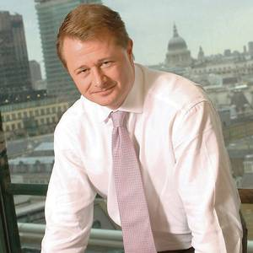
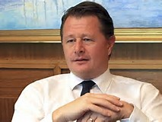
CEO’s Message
This Bank needs to live up to the reputation that we are creating with humanity, transparency and professionalism in the face of constantly changing regulatory framework and economic environment. That's why we need to change our mind set.
Get a winning mind-set:
Embrace high standards that enable us to compete with world class organisations,
winning mind-set starts with you as Ambassadors
EMBRASE CHANGE
Transparency
Integrity
Professionalism

Slide 14

Pillar 4: Bribery Risk Assessment (section 4.5 of ISO 37001)
Proportionate and Risk Based approach. Assess the bribery and corruption risks periodically and refresh this assessment.
Identify Red Flags such:
  operations in countries with a high propensity for corruption
  the extent of business conducted with government and other public officials
  the volume and nature of business conducted through sales agents and other third parties
  sales processes where business entertainment is a significant element of winning business
  the reputation of key vendors
  excessive expenses
Enhance controls and monitor

Slide 15
Pillar 5: Operations & Due Diligence (section 8 of ISO 37001)
The Group applies due diligence procedures taking a proportionate and risk based approach, in respect of persons who perform or will perform services on its behalf. The Bank maintains adequate procedures to:
Carry out due diligence checks before appointing new employees or agents.
Scrutinise expenses claims.
Ensure that any corporate hospitality given or accepted is proportionate and reasonable.
Avoid dealing with contractors and suppliers known or reasonably suspected to be paying bribes or being involved in corrupt activities.
Perform strict due diligence on associated persons/third parties in order to (a) identify the associated person and validate their credentials and background and (b) confirm the suitability of their specific skills and experience for the role they will be performing.
Ensure that contracts of employment reflect the Group’s policy and make clear that disciplinary proceedings, including proceedings leading to dismissal for gross misconduct, will result if an employee is engaged to bribery or corruption

Slide 16
Pillar 6: Support (section 7 of ISO 37001 etc)- Our procedures and other related policies
Extensive Training (e.g. e-learning)
Gift Registry
Gifts, hospitality and corporate sponsorship Procedures and thresholds
Charitable contributions & donations Procedure
Political Donations
Employees Code of Conduct
Whistleblowing Policy and Procedure
HR recruitment process
Group Procurement Policies
Conflict of Interest Group Policy
Fraud Management Policy
MiFID II Inducements Policy

Slide 17


Whistleblowing Policy
Tone at the Top to blow the whistle
Principles & implementation Procedures
Protection
Additionally the Whistleblowing Champion ensures and oversees the integrity, independence and effectiveness of the group’s policies and procedures on whistleblowing.

Slide 18
CEO’s Message to ‘speak up’
Our CEO to his message to all staff stated the following:
"Integrity and accountability are core values for us at Bank of Cyprus and are fundamental to the success of our Group. Each of us has an ethical obligation to raise issues of concern that adversely affect or potentially affect our stakeholders, our business or our reputation in general. With this in mind, we encourage you to speak up when you do not feel comfortable to use other normal channels and use the whistleblowing procedure to report suspected violations and raise concerns about practices or conduct that is contrary to our values and principles.
Be assured that anything you report will be dealt with in an independent and confidential manner and any retaliation, harassment or intimidation against any employee who raises concerns in good faith will not be tolerated by the management of the Bank. Should employees experience any form of retaliation as a result of using the whistleblowing channel, I can provide you with my personal assurance that the appropriate measures will be taken.
We rely on you to uphold our core values of ethics and conduct our business honestly, fairly and with integrity. So please Speak Up on matters that you believe need your voice."

Slide 19
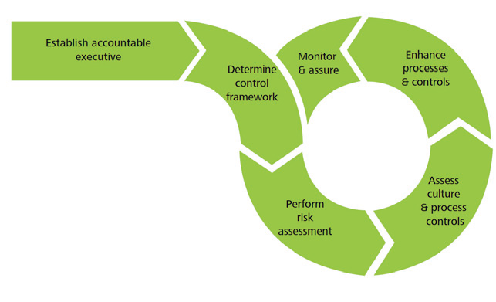
Pillar 7: Performance evaluation (section 9 of ISO 37001)
Accountability
Robust controls
On-site visits
On-going reviews
Risk assessments
Management reviews/ Assurances

Slide 20

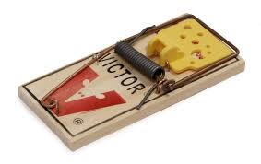
Beware of the Traps
Time pressure
Tyranny of Goals
Obedience to Authority
Small steps
Lost in the Group
Power
Renaming
Underestimate
We Won’t Get caught

Slide 21
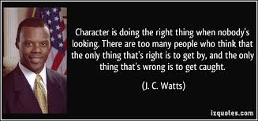
Final Trigger Points
Follow the Letter and the Spirit of Rules e.g. ISO 37001
Tone at the Top
Encourage ‘speak up processes’
Invest in Culture
Embed anti-bribery principles as to Business as usual Procedures
Beware and manage the traps …
Do Not Forget -You are an Ambassador

Slide 22

In Bank of Cyprus
Anti-bribery is a culture and not just a requirement.
We all work and care for our brand!

Slide 23
Implementation of
ISO 37001 Anti-Bribery Management System Standard
at Bank of Cyprus
THANK YOU
Kalia Larkou – Manager
Regulatory & Ethics Compliance Department
14 September 2017

