Slide 1
EN 16931-1 Semantic data model of the core elements of an electronic invoice
E-invoicing Training conference
Nicosia, October 30, 2017
Fred van Blommestein
This presentation expresses the position of the above mentioned presenter. Not of CEN.

Slide 2
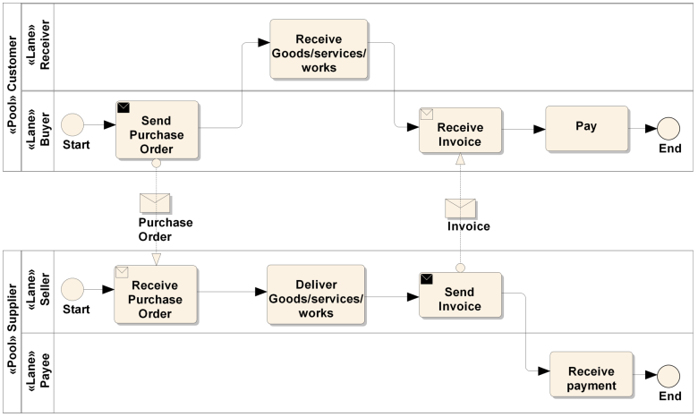
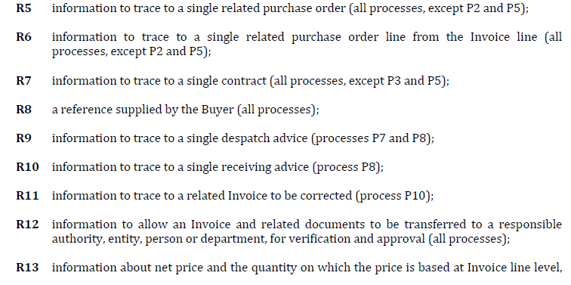
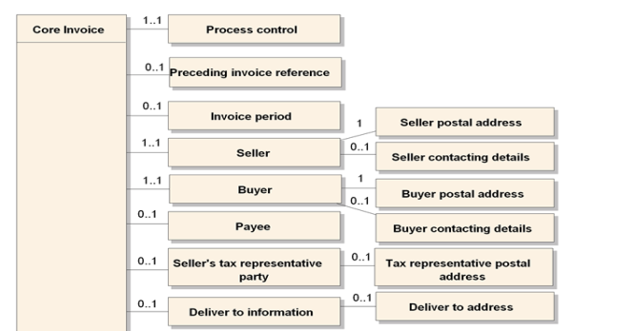
Approach EN16931-1
Process models
Invoice functions
Semantic model

Slide 3
Core invoice
Designed for a limited set of processes:
Invoicing of deliveries of goods and services against purchase orders, based on a contract;
Invoicing deliveries of goods and services based on a contract;
Invoicing the delivery of an incidental purchase order;
Pre-payment;
Spot payment;
Payment in advance of delivery;
Invoices with references to a despatch advice;
Invoices with references to a despatch advice and a receiving advice;
Credit notes or invoices with negative amounts, issued for a variety of reasons including the return of empty packaging;
Corrective invoicing (cancellation/correction of an invoice);
Partial and final invoicing;
Self billing.
Other processes may be supported as well

Slide 4
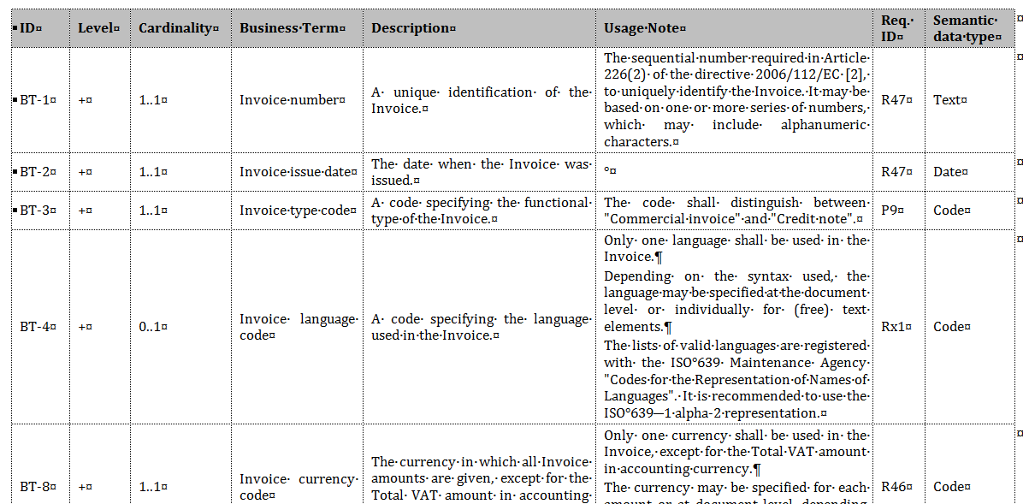
Semantic model

Slide 5
Semantic model
About 160 elements in 33 element groups
Some 25 mandatory elements
Each element has a:
Name
Definition
Cardinality (mandatory/optional/repeating)
Datatype
9 datatypes: amount, unit price amount, quantity, percentage, identifier, document reference, code, date, text, binary object

Slide 6
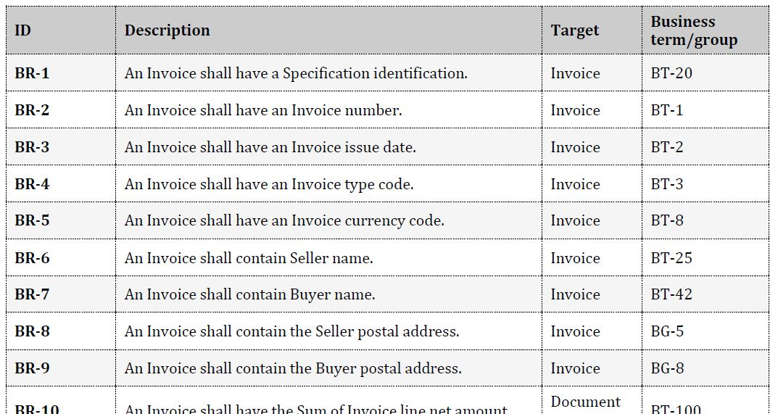
Business rules

Slide 7
3 types of rules
Integrity rules (mainly cardinality definitions)
Conditions (dependencies between elements)
VAT rules

Slide 8
Principles
Core invoice is not sector specific
Limited number of information elements that are commonly used
Sufficient for all legal and most commercial requirements
Straight-through processing
Core invoice can be processed by ordinary invoice processing systems
Sector specific information can be:
Included in free text or attached as additional documents
Included in sector specific extensions (outside scope of EN)

Slide 9
Features and limitations
One order, one delivery per invoice
Yet: invoice period at line level as well
Credit notes and negative invoices are allowed
VAT and non-VAT taxes
Types of attachments are limited (pdf, png, jpg, csv, xslx, ods)
Compliant to VAT directive
Textual payment terms
3 Payment methods, pre-payments

Slide 10
One order-one delivery-one invoice
Easier to process
Automatic validation
In case of dispute: payment of only one delivery is held back
Periodic invoicing is still possible
But no reference to individual deliveries
Periods on header and line level

Slide 11
Special cases
Part- and final invoices
VAT reverse charged
Continuous supply
Goods identification
Invoice- and delivery addresses different
Payment penalties / allowances
Allowances and charges
Header
Line

Slide 12
Process integration
The invoice is towards the end of the transaction
Automation of catalogs and orders is probably much more profitable
UBL- and UN/Cefact messages exist
CEN/TC440 even integrates pre- and postaward
Pre-award
Post-award
e-Notification
e-Submission (e-Attestation)
e-Access
e-Evaluation
e-Awarding (e-Auction)
e-Request (e-Catalogue)
e-Ordering
e-Fulfilment
e-Invoicing
e-Payment
e-Contract
Supplier and contract management
Planning

Slide 13
Questions?

