Slide 1

A SME Journey through the CRA
Conor McGoveran, CTO
5th of May 2025

Slide 2


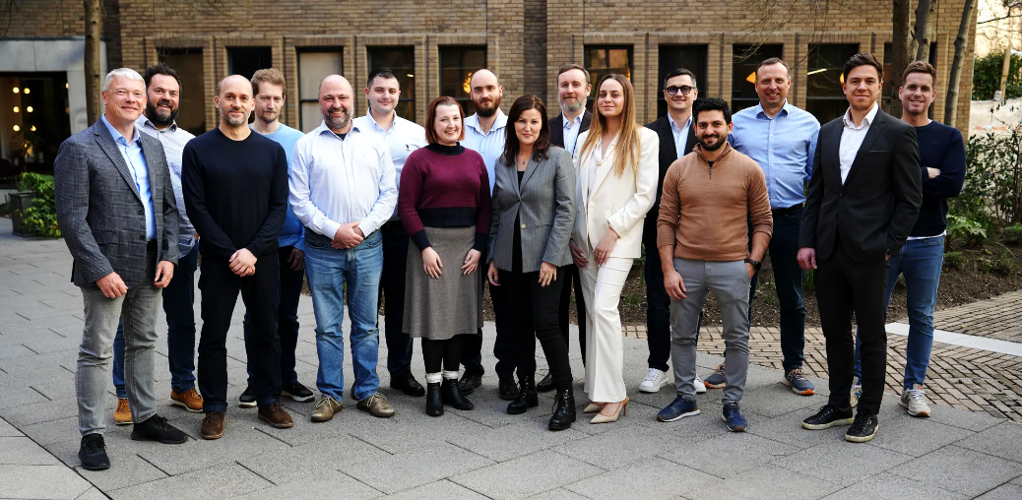


CRA - AI
The project funded under Grant Agreement No. 101190243 is supported by the European Cybersecurity Competence Centre
CYBER RESILIENCE ACT
ARTIFICIAL INTELLIGENCE
Cyber Cert Labs brought together a consortium of cyber security niche expertise from across six EU member states to work with us on this project. The total project budget is €2.9 million and will be executed over 2 years starting on January 1st 2025. Cyber Cert Labs are the Co-Ordinator and will build the core AI software platform. The platform will guide SMEs manufacturers of products with digital elements through the process of attaining and maintaining the CE mark for cyber security. The platform will have APIs with security testing capabilities to ensure vulnerability management requirements are met and a CRA training platform to educate the SMEs. The outputs from the software will prepare SMEs for self assessment and where required will streamline the process to 3rd party assessment bodies.
Watch videos about the project
https://www.cybercertlabs.com/cra-ai/

Slide 3




The project funded under Grant Agreement No. 101190243 is supported by the European Cybersecurity Competence Centre
“The CRA-AI project will build highly automated AI enabled software to support SMEs on every steps of their journey to achieve compliance with the Cyber Resilience Act”
Co-Ordinator – Cyber Cert Labs
Consortium of cybersecurity experts from six member states
Ireland, France, Spain, Belgium, Lithuania, Romania

Slide 4

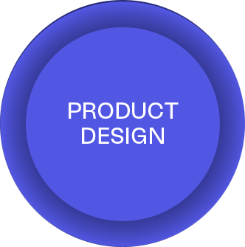
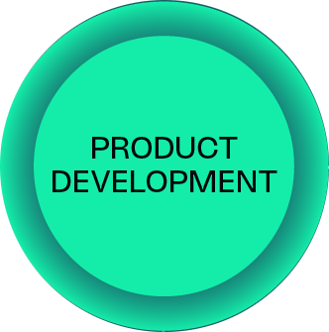



5 Key Stages

Slide 5
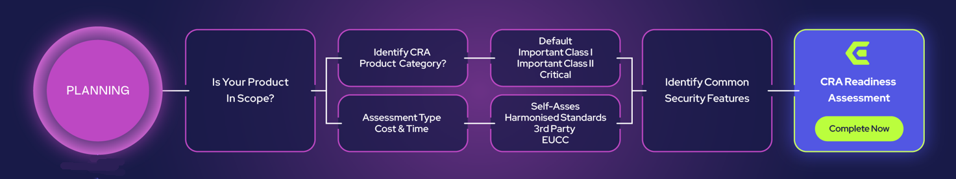
Planning

Slide 6
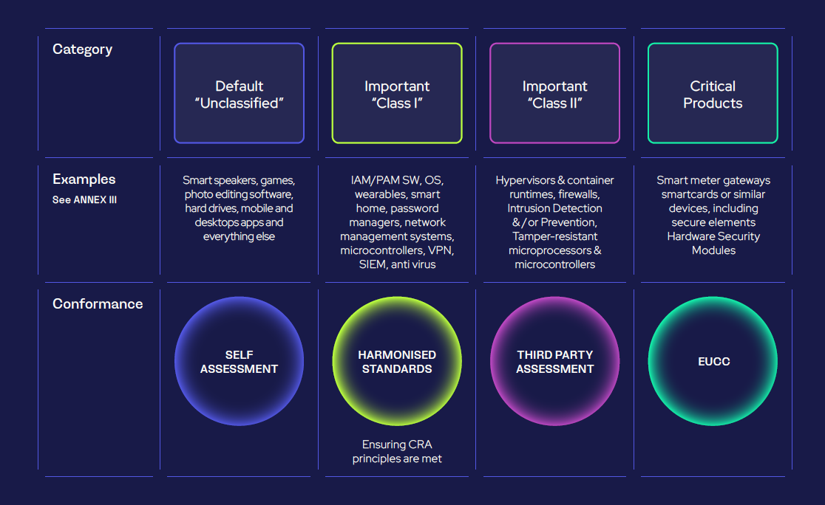
Planning

Slide 7
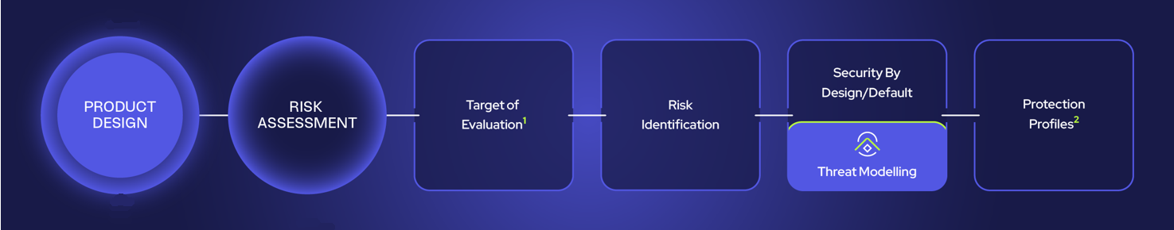
Product Design

Slide 8
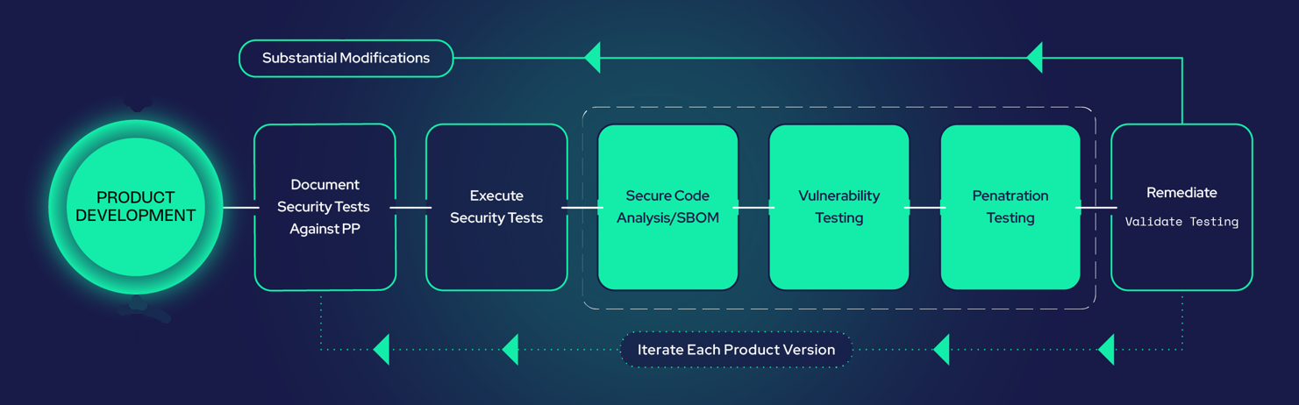
Product Development

Slide 9
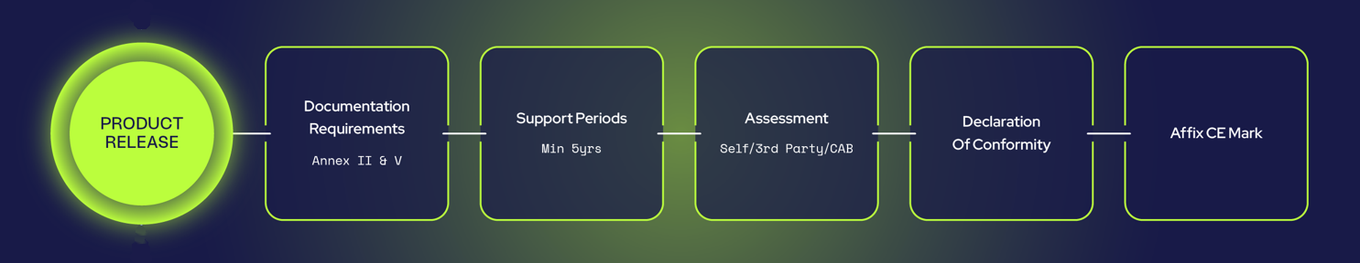
Product Release

Slide 10
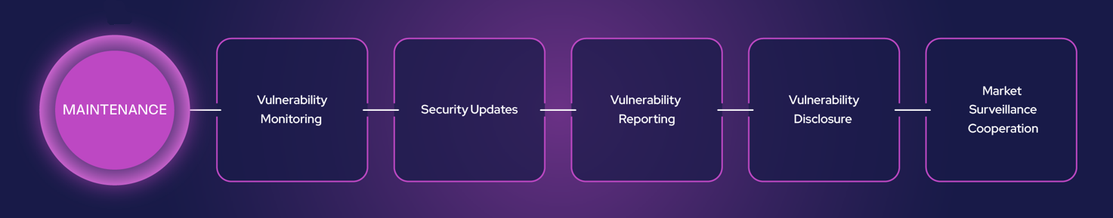
Maintenance

Slide 11
The project funded under Grant Agreement No. 101190243 is supported by the European Cybersecurity Competence Centre
“The CRA-AI project will build highly automated AI enabled software to support SMEs on every steps of their journey to achieve compliance with the Cyber Resilience Act”
Co-Ordinator – Cyber Cert Labs
Consortium of cybersecurity experts from six member states
Ireland, France, Spain, Belgium, Lithuania, Romania

Slide 12
Cyber Cert Labs
Temple House, Temple Road, Newtown Blackrock, Dublin, Ireland.
Contact
Conor McGoveran Chief Technology Officer
Project Co-Ordinator - CRA-AI
Mobile: +353 872038598 Email: conor@cybercertlabs.com
cybercertlabs.com

